Slide 1
Statements

Slide 2
Topics
The ? operator
The conditional expression
Swith
Nested switch
Expression statement
Block statement

Slide 3
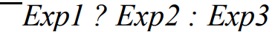
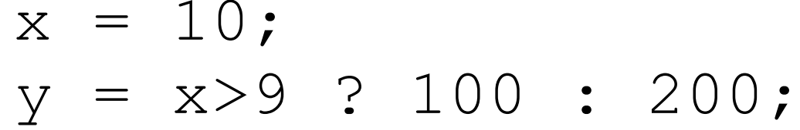
The ? operator
Syntax:
Exmpl:
If true
If flase

Slide 4
The ? operator
Exmpl:
scanf("%d", &t);
t ? printf(“not zero”) : printf("zero.");
If true
If flase

Slide 5
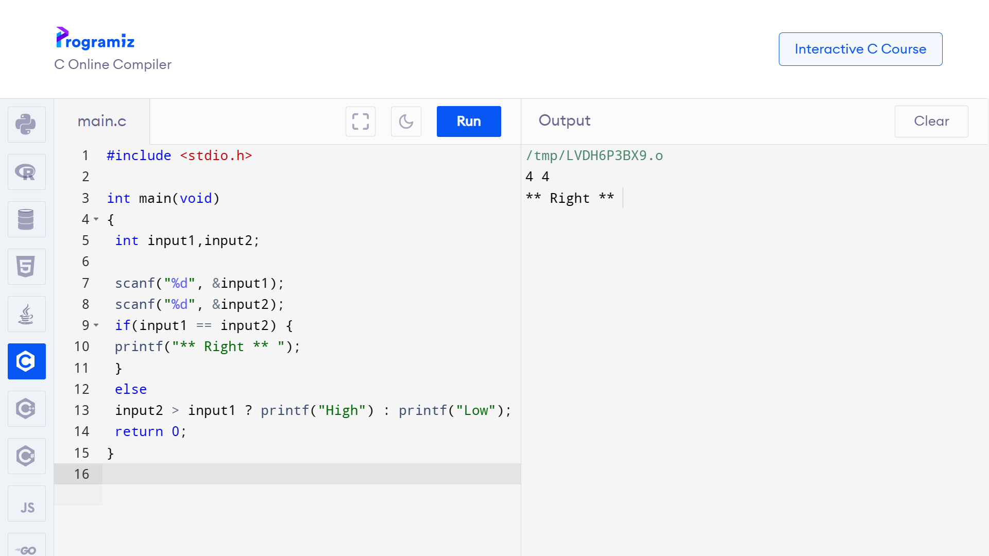
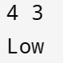

The ? operator
input:
output:

Slide 6
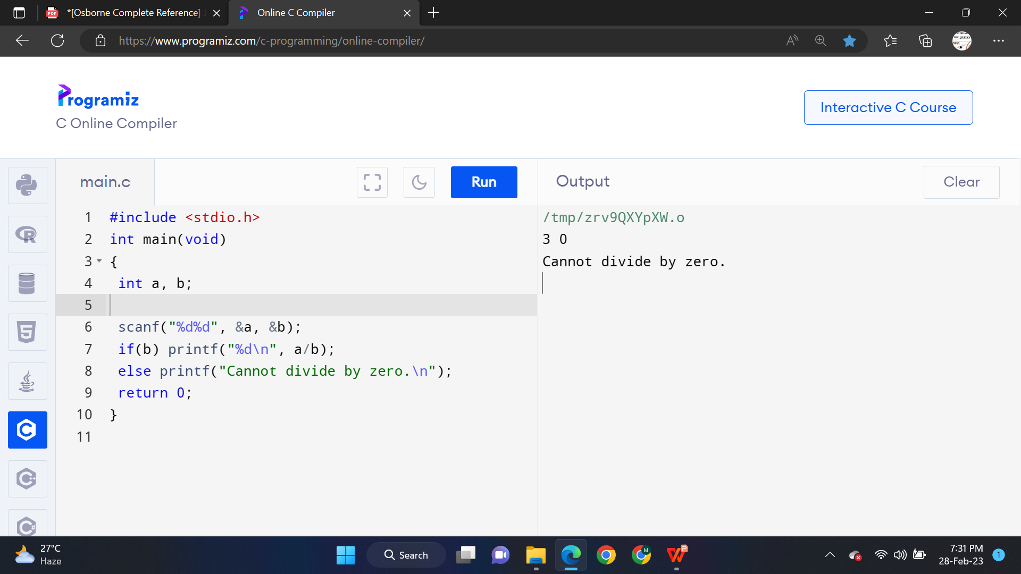
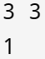
The Conditional Expression
input:
output:

Slide 7
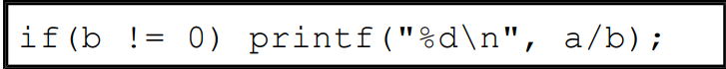
The Conditional Expression
A valid but redundant, potentialy inefficient statement; bad style

Slide 8
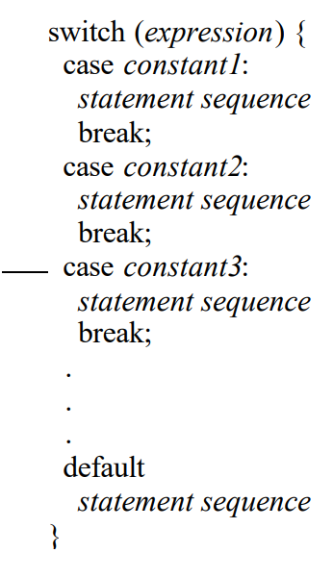
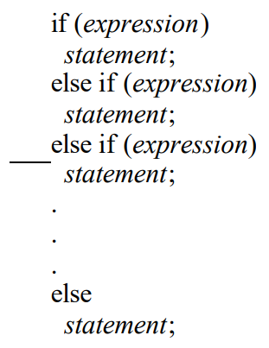
Switch
Comparing switch-case with if-else-if ladder/staircase
Syntax
“int” or “char”, nothing else!
Deals with MATCHING
Deals with TRUE-FALSE

Slide 9
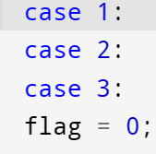
Switch
For case 1, 2, 3, same statement is executed

Slide 10
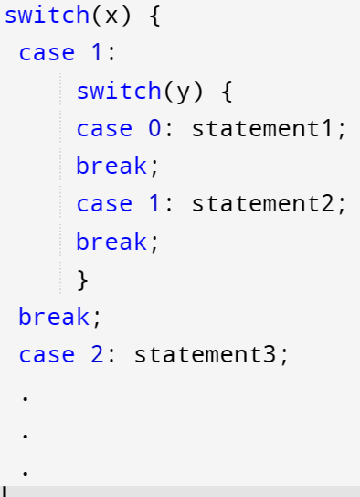
Nested switch

Slide 11
Expression statements
Some examples
x = ( y + 3 ); /* Assignment expression */
x++; /* Increment expression */
x = y = 0; /* 1 value to multiple assignment expression */
func( arg1, arg2 ); /* Function call expression */
y = z = ( f( x ) + 3 ); /* Function-call expression */
b+f(); /* Function call expression */
; /* Null expression */
a valid expression followed by a semicolon;

Slide 12
Block statement
/compound statements
Some examples
{ ***statements**
}
int main(){ ***statements***
}
if(){ ***statements***
}
/* Blocks without a header */
/* Blocks with a header */
/* Blocks with a header */
{1,3,2,4,5}; /* Not a block */

Slide 13
Thank You
Prepared by: Mehrin Farzana
ID: 2101013
Group: 4
Date: 1-3-23
Design credit: Mehrin Farzana (2101013)

